Slide 1

AI Based Career Counselling and Career Transition Recommender System
Final Year Project – Design Presentation
By
Fizza Mazhar – 21-SE-017
Asad Shah – 21-SE-021
Supervisor: Miss Amber Urooj

Slide 2
Problem Statement
Students after 12th grade often lack proper guidance to choose suitable career paths.
Many are unaware of available fields of study, their scope and growing or declining trends.
Poor career choices lead to suboptimal educational and professional outcomes.
There’s a need for a system that provides tailored recommendations based on academic scores, interests and market trends.
Notes:
Structured Problem Statement Format (Key Attributes):
Problem Definition:
Concisely state the problem, specifying its nature, scope, and any crucial details. Be clear and specific about what the issue entails.
Impact and Consequences:
Highlight the impact of the problem on relevant stakeholders or outcomes. Briefly outline the consequences of not addressing the issue.
Objective or Goal:
Clearly state the primary objective or goal that addressing the problem aims to achieve. This provides a focal point for solution development.
Proposed Solution:
Provide a brief overview of the proposed solution or initial approach to resolving the problem. This serves as a starting point for further discussion and planning.

Slide 3

Features
Personalized field and university suggestions based on academic data, interests, and trends.
Calculates aggregate scores using user-provided marks.
Displays growing and declining fields with global demand insights.
Interactive chatbot helps users identify interests and suitable fields.

Slide 4
Functional Requirements
User Registration and Login
Data Input and Validation
Field Recommendation
Aggregate Calculation
University Recommendation
Trend Visualization
Admin Management

Slide 5
Non-Functional Requirements
Performance
Scalability
Security
Usability
Reliability
Maintainability
Portability
Data Integrity
Logging

Slide 6
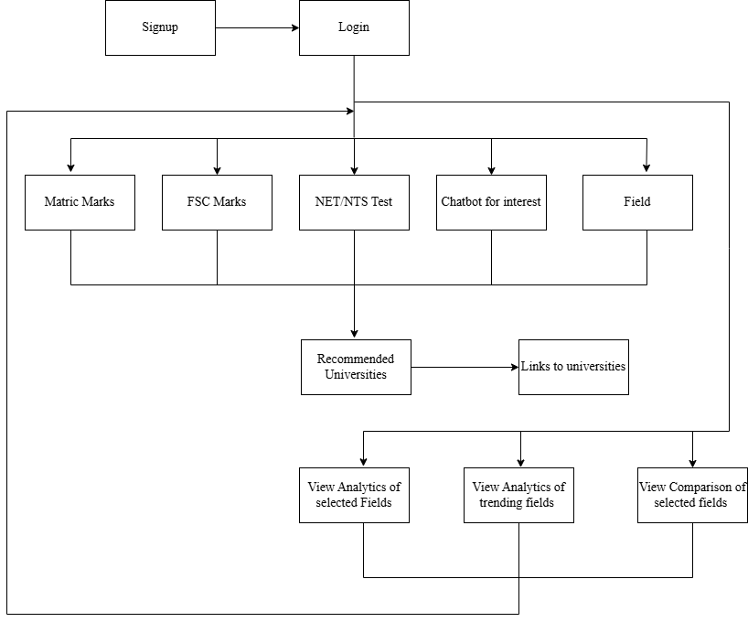
Abstract Design

Slide 7
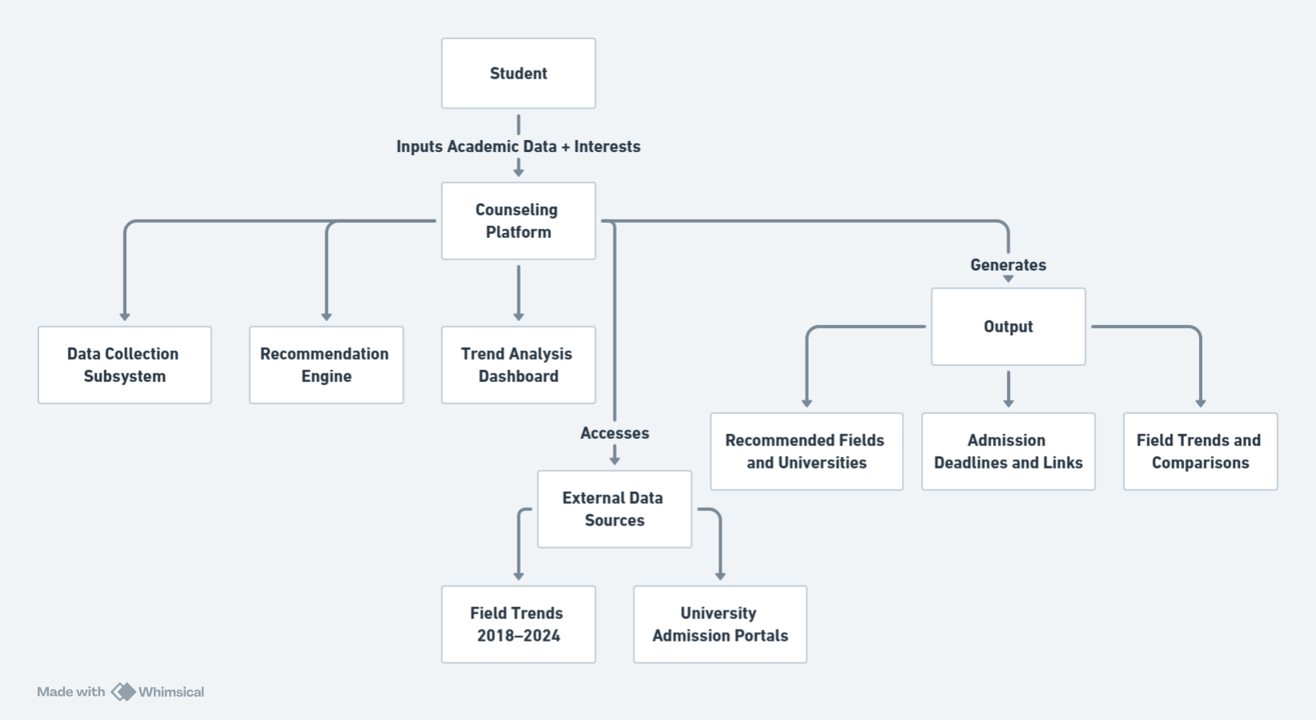
System Diagram

Slide 8
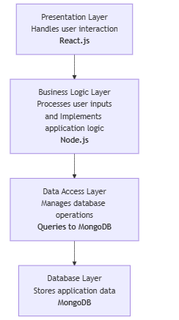
Layered Architecture PATTERN

Slide 9
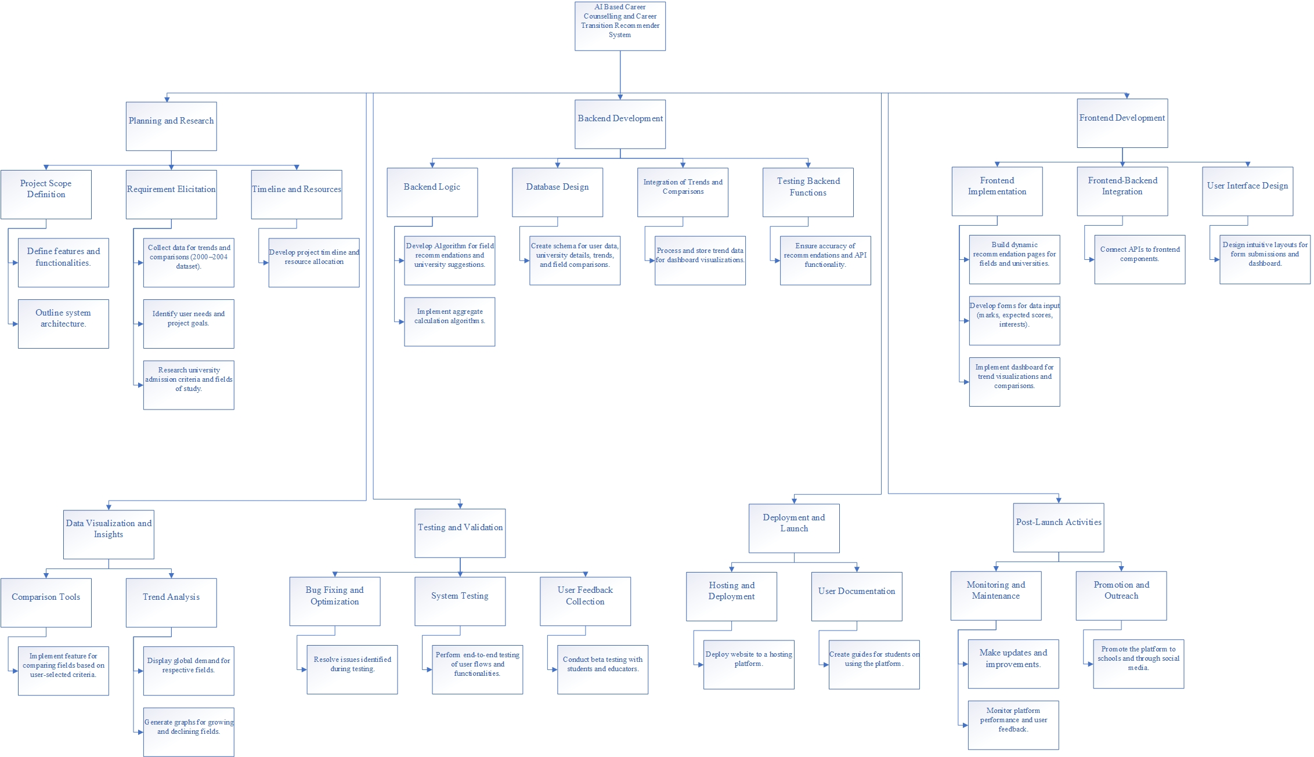
Work Breakdown Structure

Slide 10
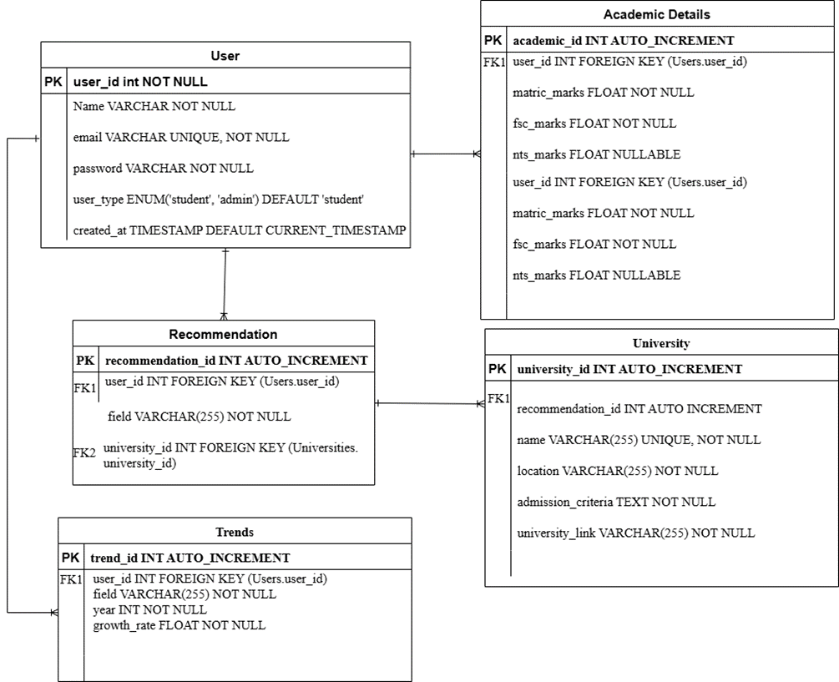
Entity Relationship Diagram

Slide 11
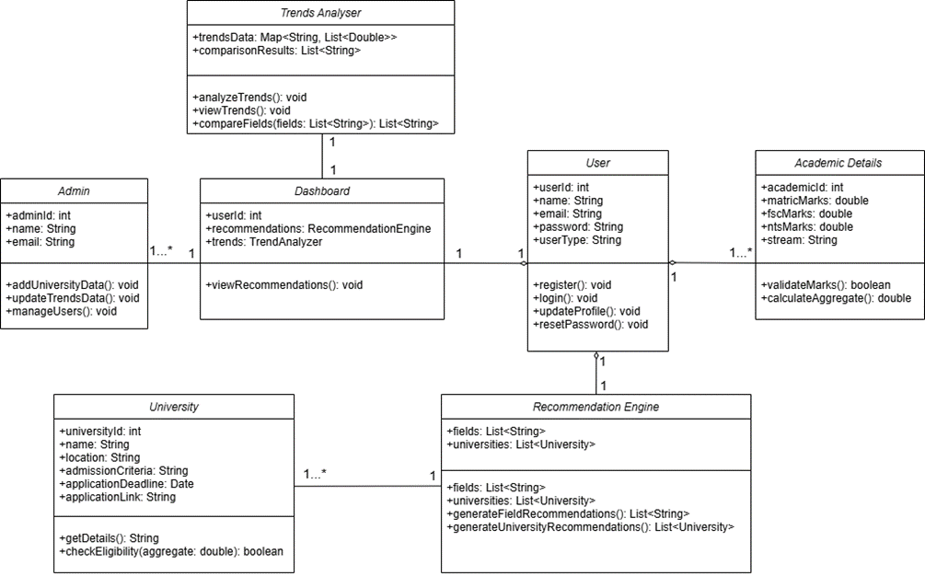
Class Diagram
12/20/2023
11

Slide 12
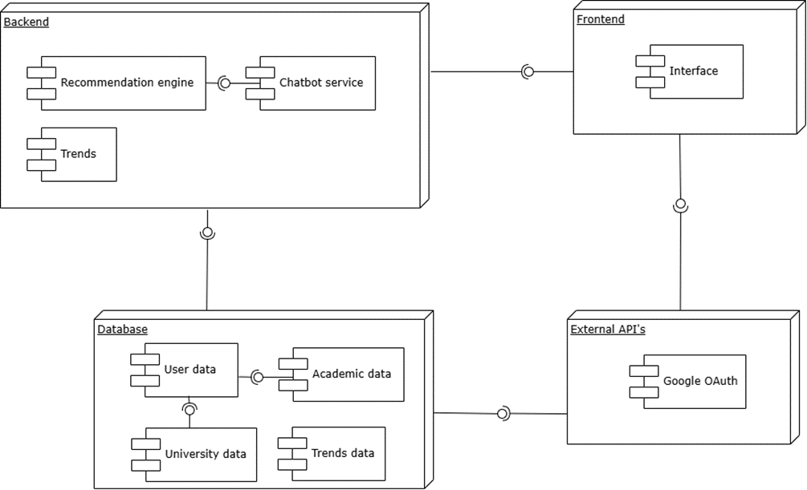
Component Diagram

Slide 13
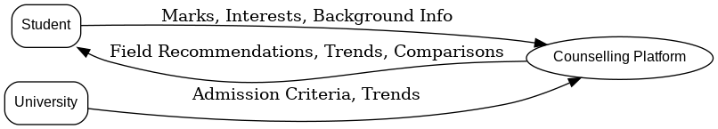
Data Flow Diagram (Context Level)
12/20/2023
13

Slide 14
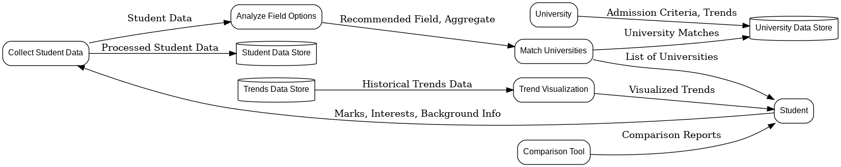
Data Flow Diagram (Level 01)
12/20/2023
14

Slide 15
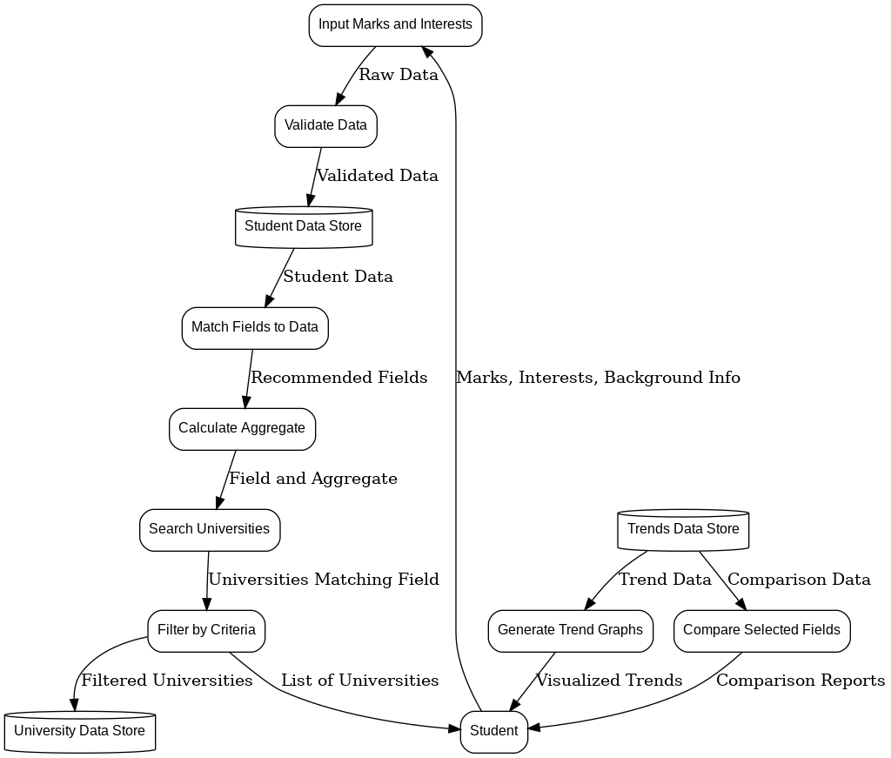
Data Flow Diagram (Level 02)
12/20/2023
15

Slide 16

GUI (Login Signup)
12/20/2023
16

Slide 17
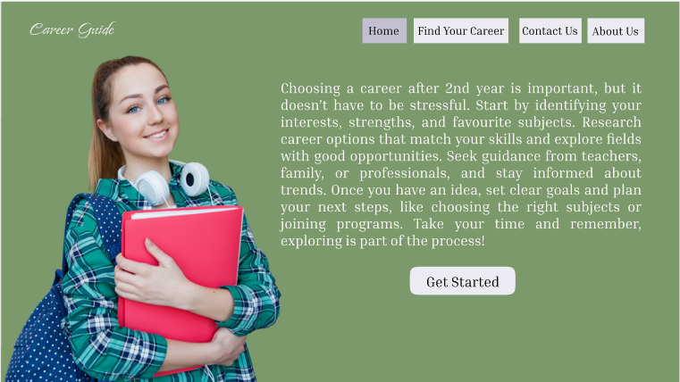
GUI (Home Page)
12/20/2023
17

Slide 18
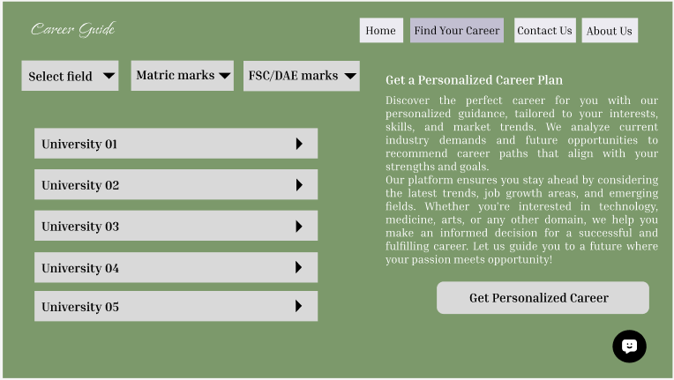
GUI (Find your career page)
12/20/2023
18

Slide 19
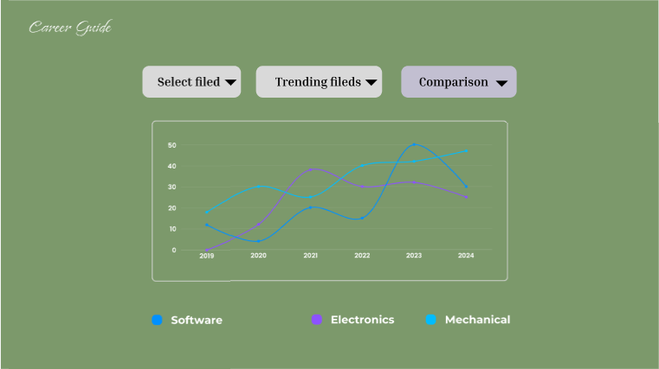
GUI (Trends visualization page)
12/20/2023
19

Slide 20
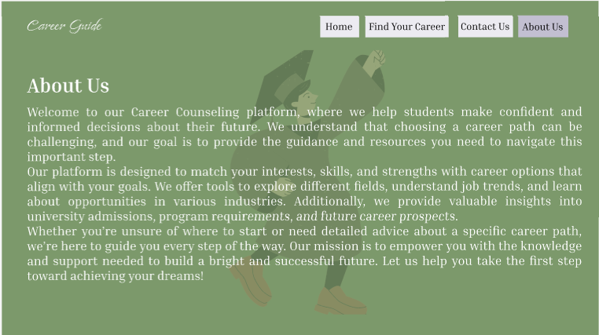
GUI (About us)
12/20/2023
20

Slide 21
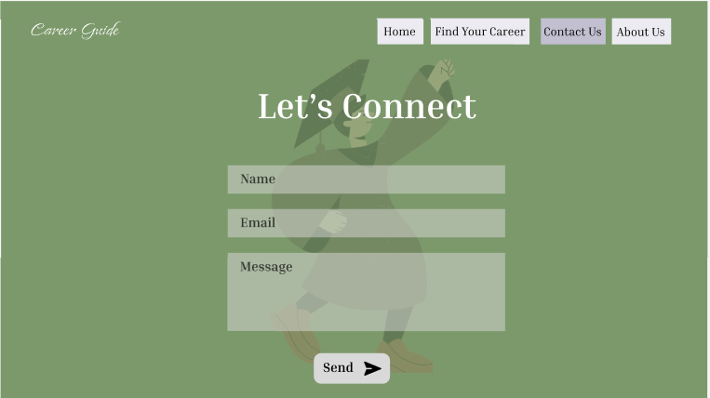
GUI (Contact us)
12/20/2023
21

Slide 22
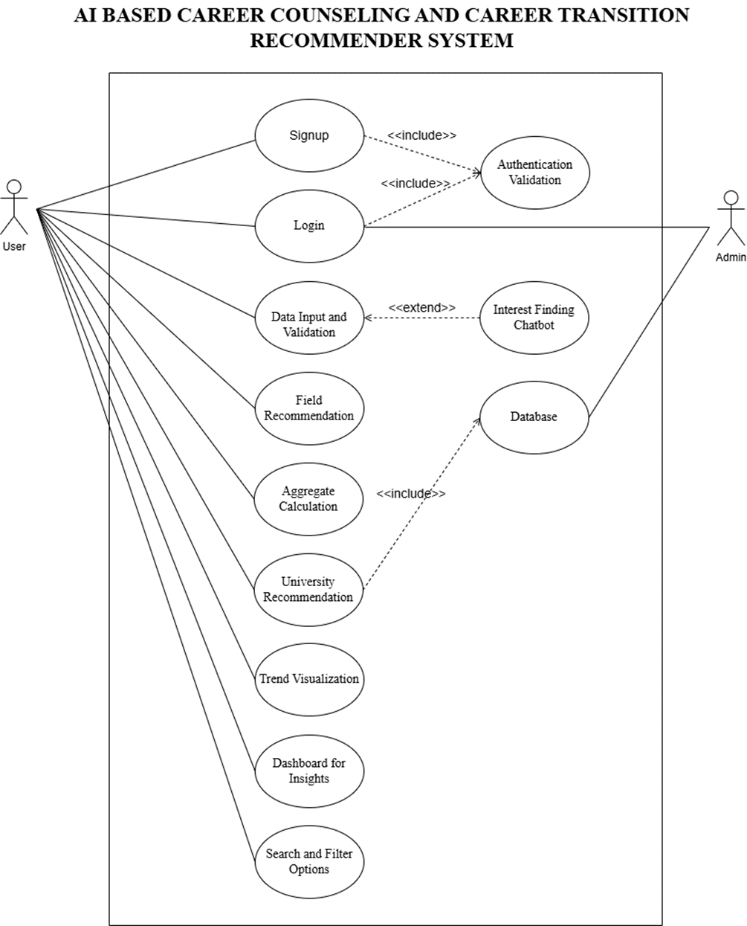
Use Case Diagram
12/20/2023
12/20/2023
22
22

Slide 23
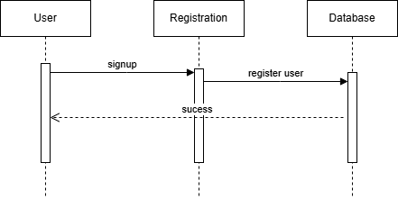
Sequence Diagram (01)
12/20/2023
12/20/2023
23
23

Slide 24
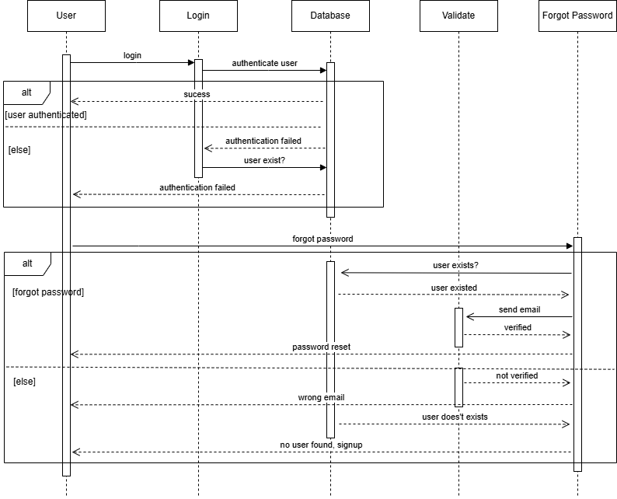
Sequence Diagram (02)
12/20/2023
12/20/2023
24
24

Slide 25
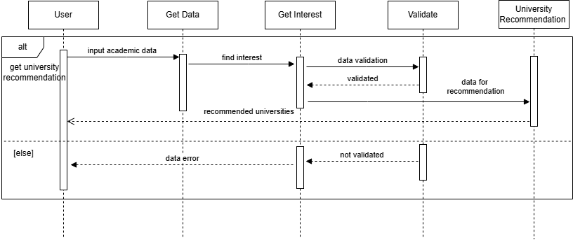
Sequence Diagram (03)
12/20/2023
12/20/2023
25
25

Slide 26
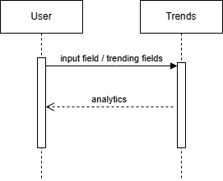
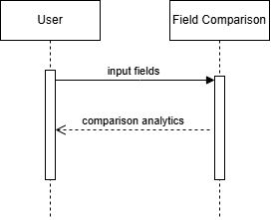
Sequence Diagram (04 , 05)
12/20/2023
12/20/2023
26
26

Slide 27
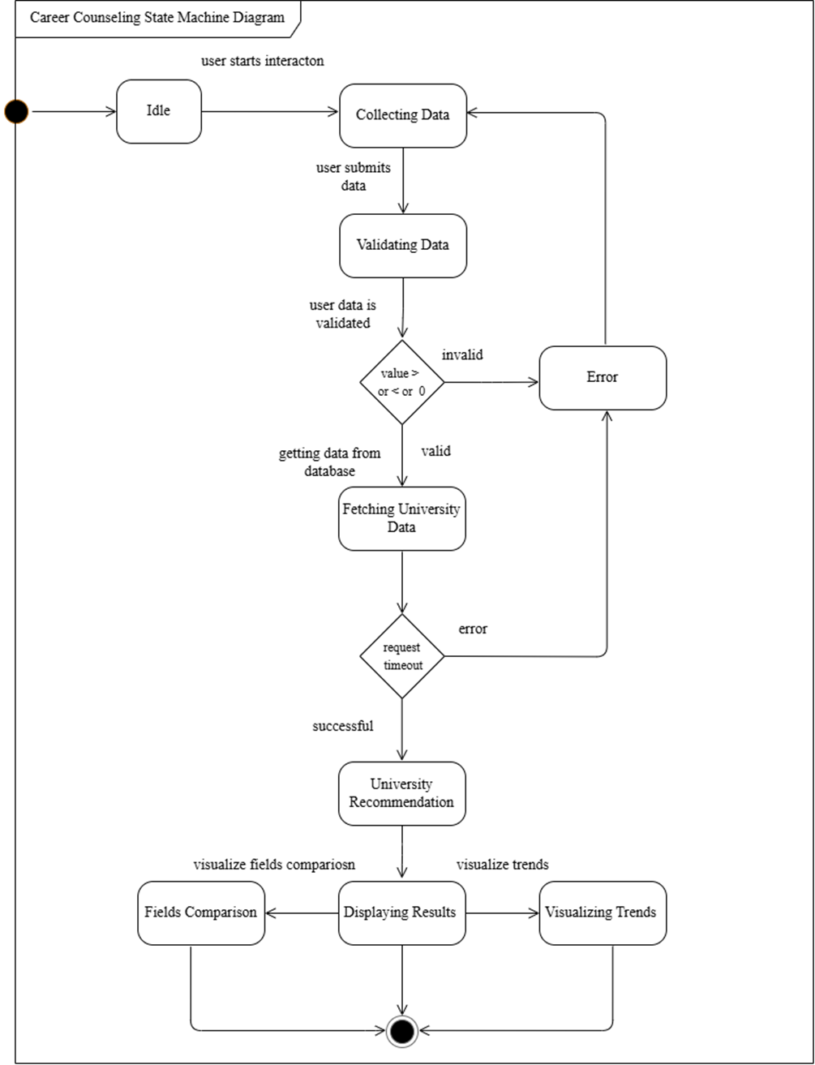
State Machine
Diagram
12/20/2023
12/20/2023
27
27

Slide 28
Quality Assurance Plan
Planning Phase: Define functional and non-functional requirements.
Design Review: Conduct peer reviews of UI/UX wireframes, database schema and algorithms.
Development QA: Perform static code analysis to ensure code quality.
Testing: Conduct various types of testing.
Validation: Confirm that the platform meets user needs through UAT.
Post-Launch Monitoring: Continuously monitor performance and collect user feedback.

Slide 29
Test Suites
1. Test Suite: User Registration and Login
Test Case 1.1: User Registration
Test Case 1.2: User Login
Test Case 1.3: Google OAuth Login
2. Test Suite: Data Input and Validation
Test Case 2.1: Input Valid Data
Test Case 2.2: Input Invalid Data
Test Case 2.3: Enter Expected Marks

Slide 30
Test Suites
3. Test Suite: Recommendation System
Test Case 3.1: Field Recommendations
Test Case 3.2: University Recommendations
Test Case 3.3: Interest-Based Recommendations
4. Test Suite: Dashboard and Trend Visualization
Test Case 4.1: View Trends
Test Case 4.2: Compare Fields

Slide 31
Test Suites
5. Test Suite: Integration Testing
Test Case 5.1: Frontend-Backend Integration
Test Case 5.2: External API Integration
6. Test Suite: Performance Testing
Test Case 6.1: Load Testing
Test Case 6.2: Stress Testing

Slide 32
Test Suites
7. Test Suite: Security Testing
Test Case 7.1: SQL Injection
8. Test Suite: Usability Testing
Test Case 8.1: Mobile Responsiveness
Test Case 8.2: Navigation Flow
9. Test Suite: Post-Deployment Testing
Test Case 9.1: Monitor Uptime
Test Case 9.2: Monitor Performance

Slide 33
Configuration Management Plan
This CMP applies to all configuration items related to the project, including:
Source code (frontend and backend).
Database schema and datasets.
Algorithms for recommendations and aggregate calculation.
Testing artifacts.
System documentation (user manuals, admin guides).

Slide 34
Roles and Responsibilities
Role | Responsibilities
Configuration Manager | Oversees configuration management activities and ensures adherence to the CMP.
Developers | Implement changes, maintain code, and commit updates to version control.
Test Engineers | Validate changes and report issues to the configuration manager.
Change Control Board | Approve or reject change requests based on impact analysis.

Slide 35
Configuration Identification
All configuration items (CIs) will be uniquely identified to ensure traceability. CIs include:
Source Code: Frontend (React.js), Backend (Node.js/Express).
Database Schema: Tables for user data, universities, recommendations and trends.
Algorithms: Field recommendation, university eligibility.
Documentation: User manuals, testing reports, and technical guides.
Testing Artifacts: Test cases, results and defect logs.

Slide 36
Configuration Control
The following steps define the control process
Change Request Submission
Change Evaluation
Change Approval/Rejection
Change Implementation
Change Verification

Slide 37
Configuration Status
Maintain records of all CIs, their versions and change history.
Generate weekly reports detailing:
Approved changes.
Pending change requests.
Current system baseline.

Slide 38
Configuration Tools
Tool | Purpose
Git/GitHub | Version control and repository management.
Jira | Tracking change requests and defects.
Cypress | Testing.
Visual Studio Code | Development environment.

Slide 39
Risk Management
Risk | Mitigation
Unauthorized changes to CIs | Implement role-based access control in version control systems.
Version conflicts | Enforce branching and merging strategies in Git.
Inconsistent documentation | Conduct regular configuration audits and maintain central records.

Slide 40
Technology & Tool Stack for SDLC
SDLC Phase | Technology/Tool
Design | Figma (UI/UX Design for wireframes and prototypes), draw.io and Visio for diagrams
Development | Frontend: React.js, HTML, CSS, JavaScript.
 | Backend: Node.js, Express.js.
 | Database: MongoDB (for user data, trends, and university details).

Slide 41
Technology & Tool Stack for SDLC
SDLC Phase | Technology / Tool
Testing | Functional Testing: Selenium, Cypress.
 | Performance Testing: JMeter.
 | Bug Tracking: Jira.
Configuration Management | Git/GitHub (Version Control)
Deployment | Hosting: AWS.
Maintenance | Jira (Bug Tracking and Updates).

Slide 42
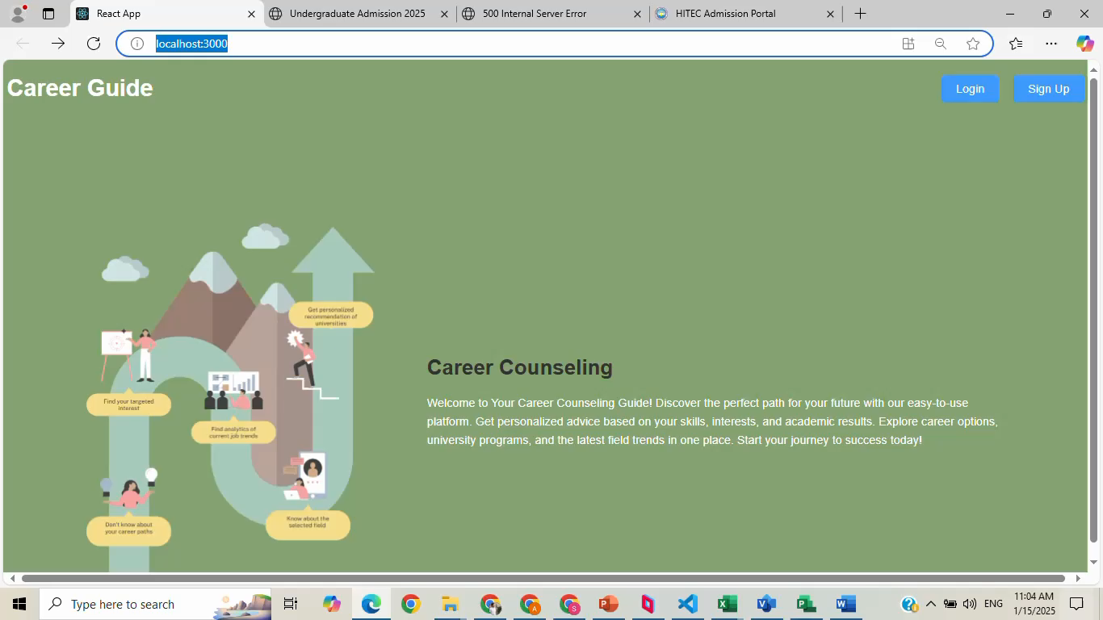
Minimum Viable Product

Slide 43
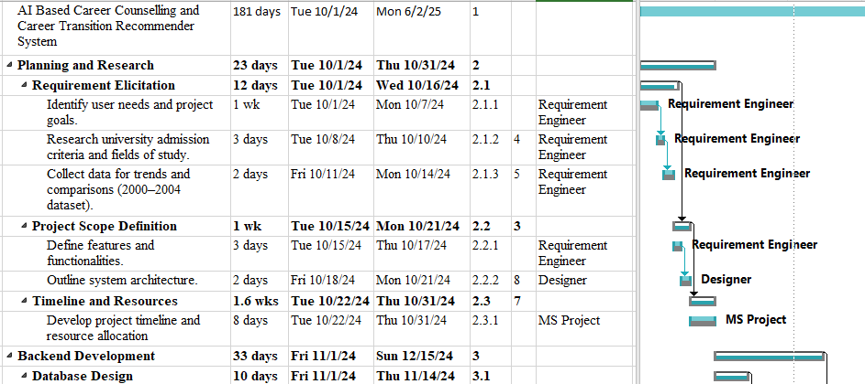
Baseline Plan / Tool

Slide 44
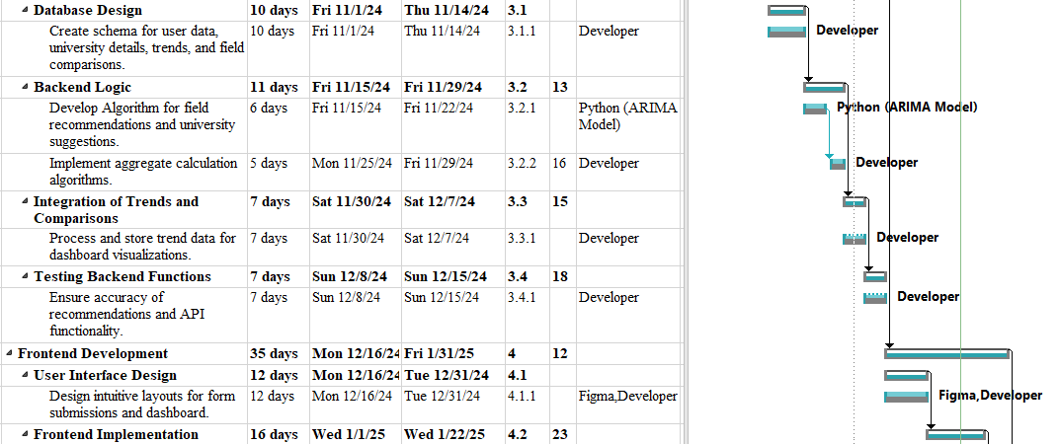
Baseline Plan / Tool

Slide 45
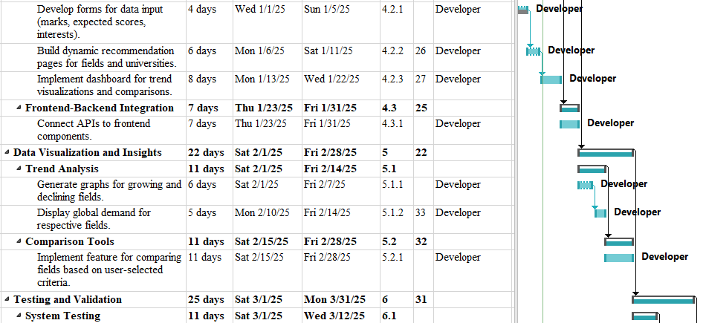
Baseline Plan / Tool

Slide 46
Thank You
Any Questions?

